Slide 1
Characterization of Carcinoma Cell Culture Subpopulations using Cyclic Immunofluorescence Data & ChatGPT
Presented by Cypress Tomaneng
May 2, 2024

Slide 2
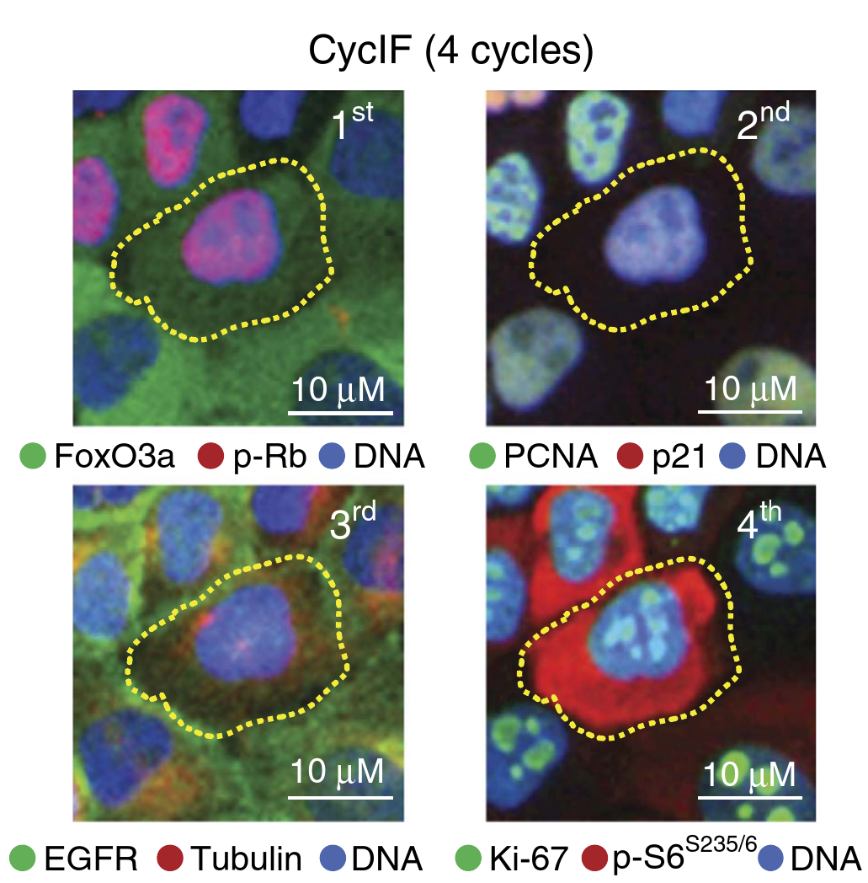
Cyclic immunofluorescence (CycIF): proteomics with a microscope
Lin et al. (2015)

Slide 3
Proteins that were manipulated
Protein of interest | Why is it of interest? | How was it manipulated? | Reference
Ankycorbin (RAI14) | Overexpressed in gastrointestinal cancers | Knockout out RAI14 gene using CRISPR-cas9 | He et al. (2018)
Fibronectin | Promotes cancer drug resistance | Coated wells with protein solution | Amrutkar et al. (2019)
Collagen I | Promotes cancer metastasis | Coated wells with protein solution | Shintani et al. (2006)

Slide 4
Research Questions
How does knocking out the gene retinoic acid induced 14 (RAI14) affect the expression of a panel of proteins relevant to cancer progression?
What subpopulations, if any, can be identified using this process?
How can code be developed to aid in answering these questions?

Slide 5
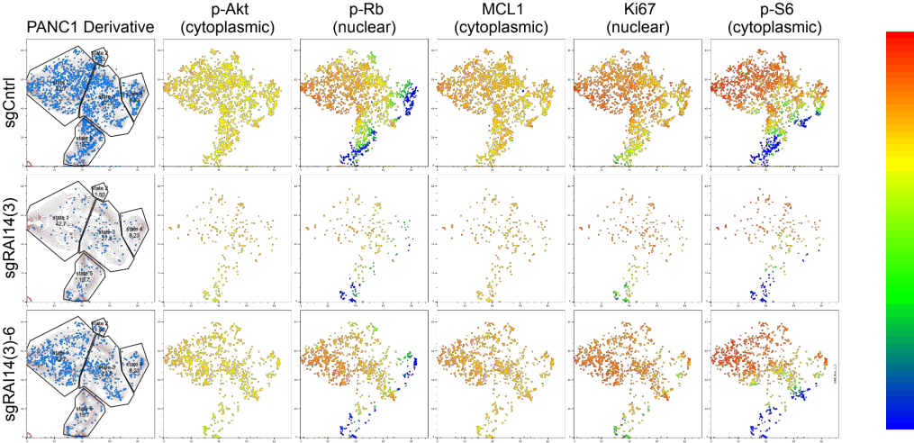
The goal

Slide 6


A problem with the old approach

Slide 7
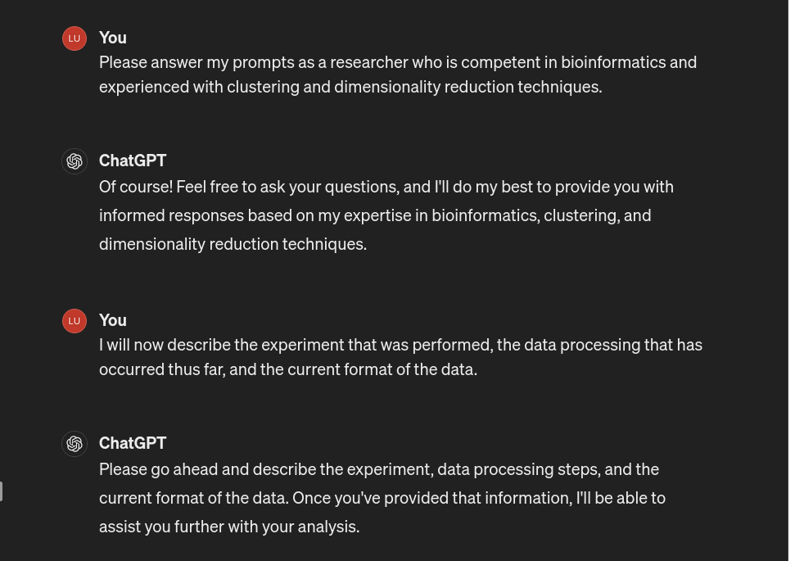
It begins

Slide 8
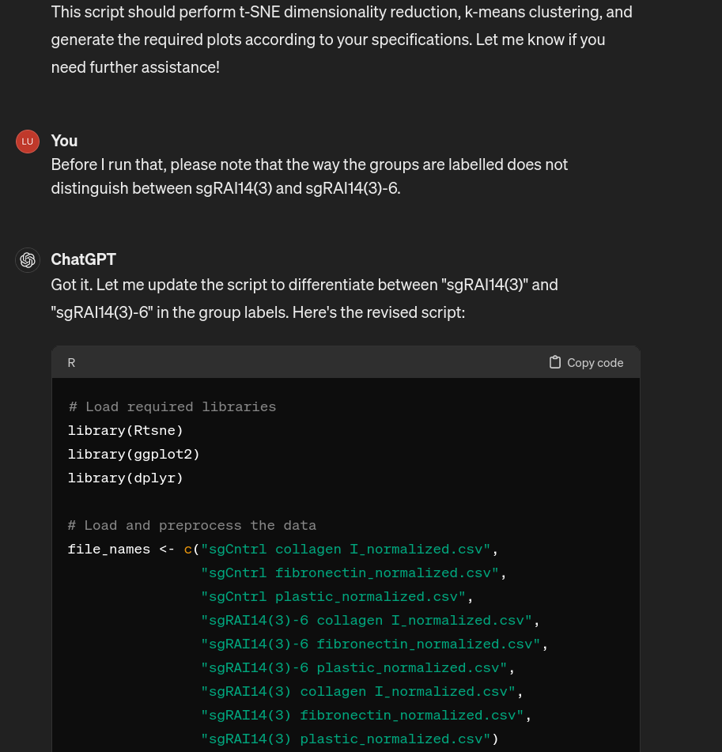
Let me stop you right there
Reading the code it gave me helped!

Slide 9
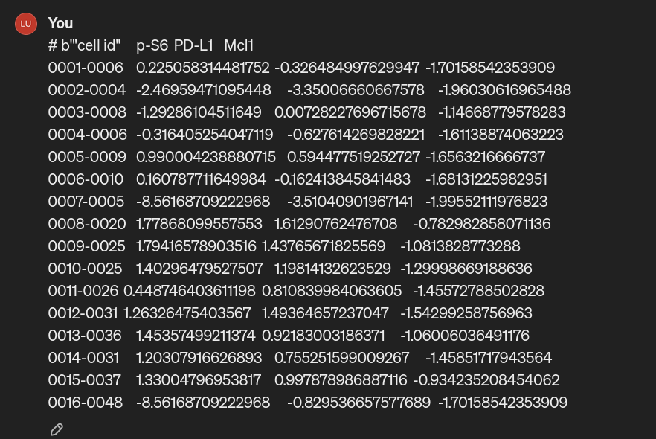
The first error thrown was my fault
Error in terms.formula(object, data = data) : '.' in formula and no 'data' argument

Slide 10
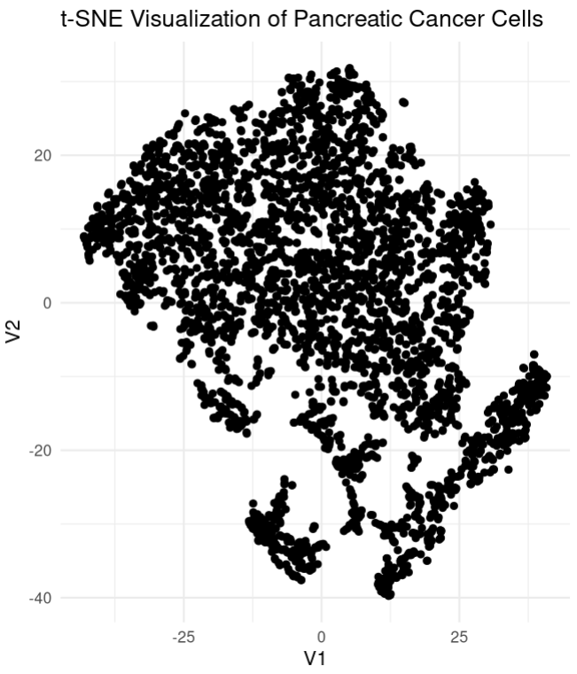
The first plot was pretty good, actually
You:
Ah, sorry. The data example I originally gave you was from when I was viewing it in LibreOffice. Here's a couple lines straight from a data file: # b'"cell id","p-S6","PD-L1","Mcl1","Vim","NF\xce\xbaBp65","p-Akt","E-Cad","Bim","p-Rb","FOXO1A","p-Stat3","SOX2","p-\xc9\xa3H2AX","Ki67","PCNA","group id"' "0001-0009",1.9239125802947985,1.2414324982383231,-0.05162593570328777,1.942928343732408,1.0055675757374303,0.06451143334709997,0.004975462858044288,0.8406068364766224,2.7815874744942306,2.696807093447756,2.866828366353664,1.8564836168323922,1.2436569710900969,3.1946143509042972,2.0216511543946947,3
Notes:
Turns out you have to give ChatGPT correct information for it to do the correct thing.
The shape of this plot was familiar; I think I've plotted this subset of my data before using SeqGeq and it resembled this R plot. Good start!

Slide 11
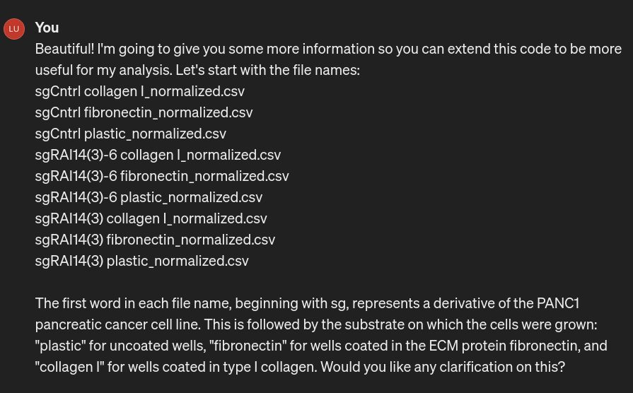
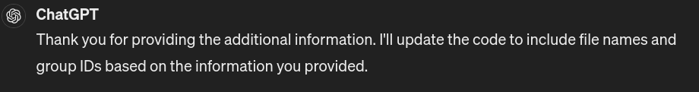
Letting ChatGPT cook

Slide 12
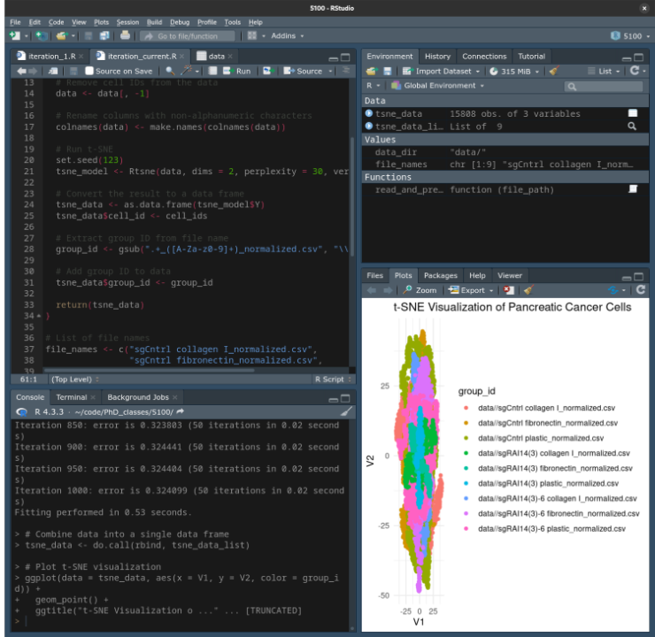
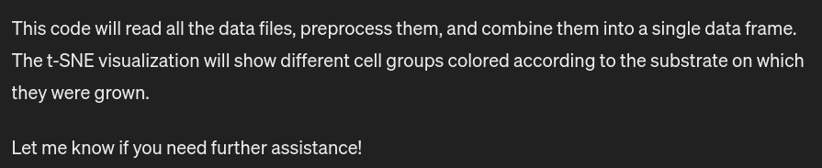
Letting ChatGPT cook
Notes:
I gave ChatGPT some file names and... it just did what I was going to tell it to do, basically.

Slide 13
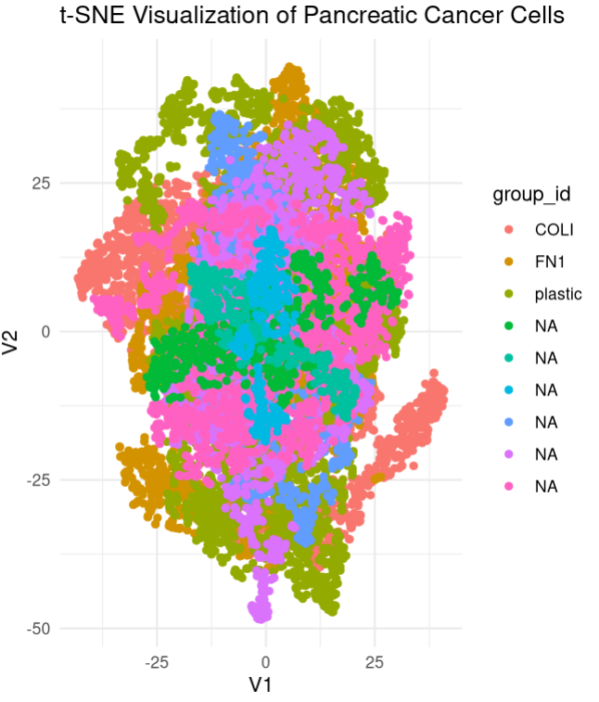
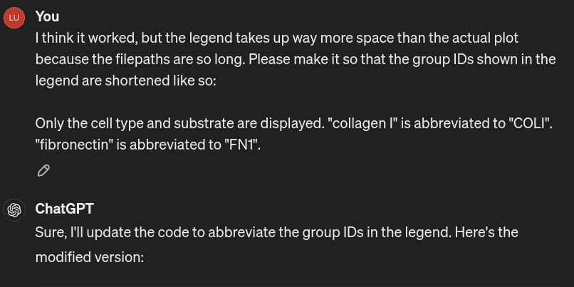
Struggling with the legend

Slide 14
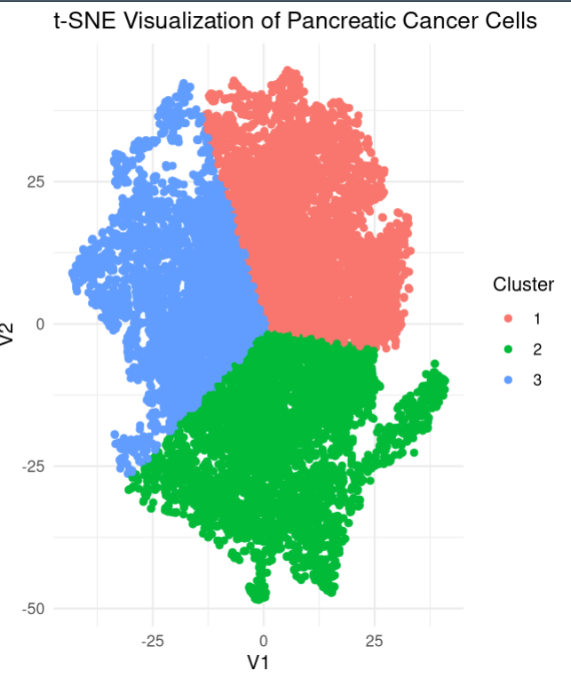
Let's try clustering!
You:
I'd like to also run k-means clustering on these data. Can you do that and map color to the cluster IDs in the t-SNE plot?

Slide 15
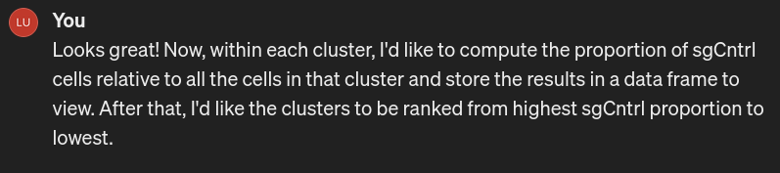
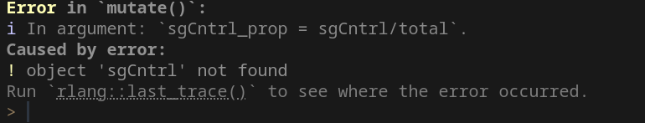
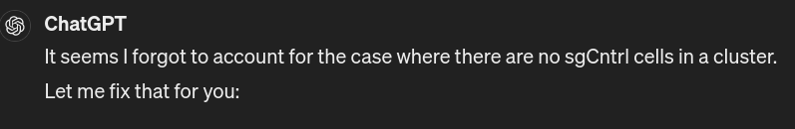
The sticking point
(It couldn't)

Slide 16
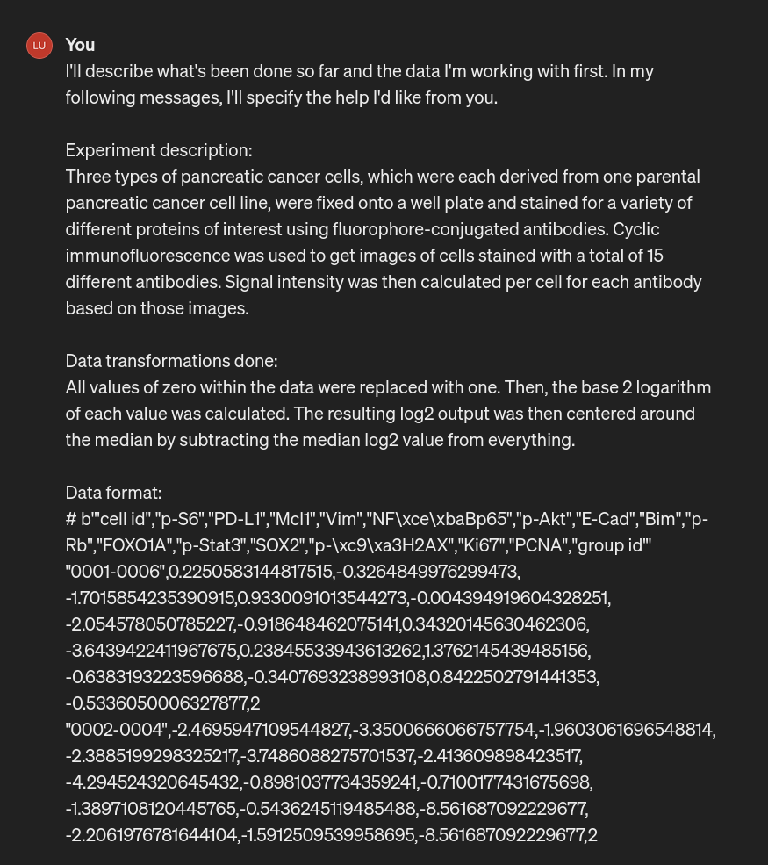
Let's start over, but with more info at once!

Slide 17
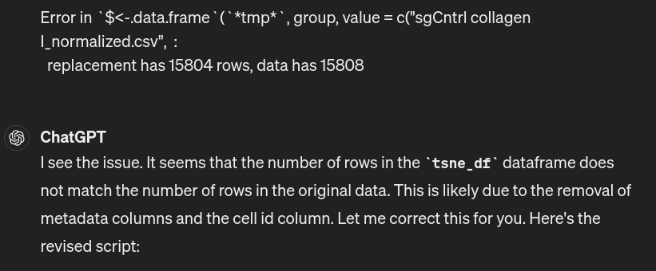
Never mind. It got stuck immediately.

Slide 18
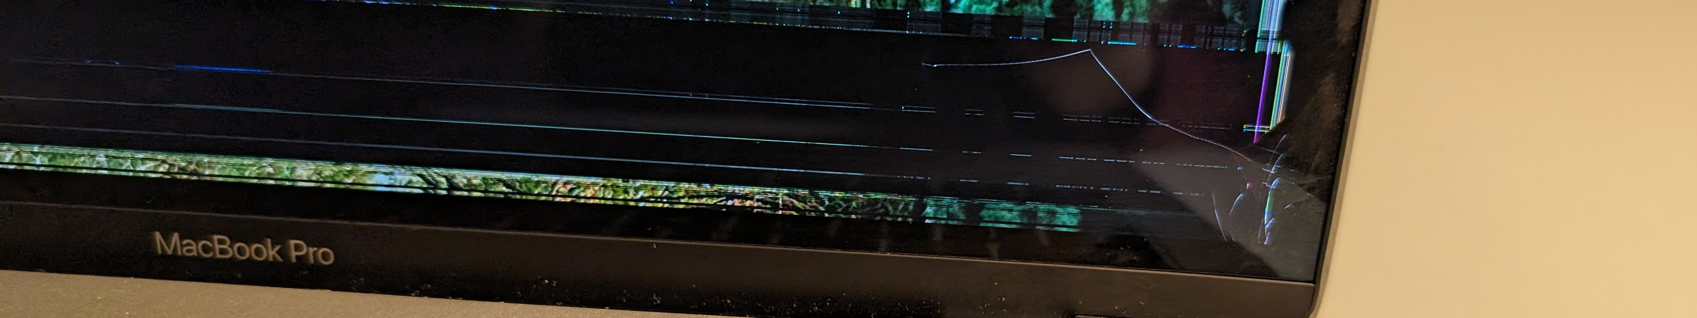
Challenges & Takeaways
I broke my computer (see above)
ChatGPT can do pretty well if you give it correct information.
Read the code it provides!
It'll take suggested fixes for issues well.

Slide 19
References
Lin, J.-R., Fallahi-Sichani, M., & Sorger, P. K. (2015). Highly multiplexed imaging of single cells using a high-throughput cyclic immunofluorescence method. Nature Communications, 6(1), 8390. https://doi.org/10.1038/ncomms9390
He, X.-Y., Zhao, J., Chen, Z.-Q., Jin, R., & Liu, C.-Y. (2018). High Expression of Retinoic Acid Induced 14 (RAI14) in Gastric Cancer and Its Prognostic Value. Medical Science Monitor, 24, 2244–2251. https://doi.org/10.12659/MSM.910133
Amrutkar, M., Aasrum, M., Verbeke, C. S., & Gladhaug, I. P. (2019). Secretion of fibronectin by human pancreatic stellate cells promotes chemoresistance to gemcitabine in pancreatic cancer cells. BMC Cancer, 19(1), 596. https://doi.org/10.1186/s12885-019-5803-1
Shintani, Y., Hollingsworth, M. A., Wheelock, M. J., & Johnson, K. R. (2006). Collagen I Promotes Metastasis in Pancreatic Cancer by Activating c-Jun NH2-Terminal Kinase 1 and Up-regulating N-Cadherin Expression. Cancer Research, 66(24), 11745–11753. https://doi.org/10.1158/0008-5472.CAN-06-2322
van der Maaten, L., & Hinton, G. (2008). Visualizing Data using t-SNE. Journal of Machine Learning Research, 9 (2008), 2579–2605.
Shue, E., Liu, L., Li, B., Feng, Z., Li, X., & Hu, G. (2023). Empowering beginners in bioinformatics with ChatGPT. Quantitative Biology, 11(2), 105–108. https://doi.org/10.15302/J-QB-023-0327

